Slide 1
CS162 Operating Systems and Systems Programming Lecture 8 Locks, Semaphores, Monitors, and Quick Intro to Scheduling
February 17th 2016
Prof. Anthony D. Joseph
http://cs162.eecs.Berkeley.edu

Slide 2
Review: Synchronization Problem with Threads
One thread per transaction, each running:
Deposit(acctId, amount) { acct = GetAccount(actId); /* May use disk I/O */ acct->balance += amount; StoreAccount(acct); /* Involves disk I/O */ }
Unfortunately, shared state can get corrupted: Thread 1 Thread 2 load r1, acct->balance load r1, acct->balance add r1, amount2 store r1, acct->balance add r1, amount1 store r1, acct->balance
Atomic Operation: an operation that always runs to completion or not at all
It is indivisible: it cannot be stopped in the middle and state cannot be modified by someone else in the middle

Slide 3
Review: Too Much Milk Solution #3
Here is a possible two-note solution:
Thread A Thread B
leave note A; leave note B; while (note B) {\\X if (noNote A) {\\Y do nothing; if (noMilk) { } buy milk; if (noMilk) { } buy milk; } } remove note B; remove note A;
Does this work? Yes. Both can guarantee that:
It is safe to buy, or
Other will buy, ok to quit
At X:
if no note B, safe for A to buy,
otherwise wait to find out what will happen
At Y:
if no note A, safe for B to buy
Otherwise, A is either buying or waiting for B to quit

Slide 4
Review: Too Much Milk: Solution #4
Suppose we have some sort of implementation of a lock (more in a moment).
Acquire(&mylock) – wait until lock is free, then grab
Release(&mylock) – Unlock, waking up anyone waiting
These must be atomic operations – if two threads are waiting for the lock and both see it’s free, only one succeeds to grab the lock
Then, our milk problem is easy:
Acquire(&milklock);
if (nomilk)
buy milk;
Release(&milklock);
Once again, section of code between Acquire() and Release() called a “Critical Section”
Of course, you can make this even simpler: suppose you are out of ice cream instead of milk
Skip the test since you always need more ice cream.

Slide 5
Review: Better Implementation of Locks by Disabling Interrupts
Key idea: maintain a lock variable and impose mutual exclusion only during operations on that variable
int value = FREE;
Acquire() { disable interrupts; if (value == BUSY) { put thread on wait queue; Go to sleep(); // Enable interrupts? } else { value = BUSY; } enable interrupts; }
Release() { disable interrupts; if (anyone on wait queue) { take thread off wait queue Place on ready queue; } else { value = FREE; } enable interrupts; }

Slide 6
Review: New Lock Implementation – Discussion
Why do we need to disable interrupts at all?
Avoid interruption between checking and setting lock value
Otherwise two threads could think that they both have lock
Note: unlike previous solution, the critical section (inside Acquire()) is very short
User of lock can take as long as they like in their own critical section: doesn’t impact global machine behavior
Critical interrupts taken in time!
Acquire() { disable interrupts; if (value == BUSY) { put thread on wait queue; Go to sleep(); // Enable interrupts? } else { value = BUSY; } enable interrupts; }
Critical
Section

Slide 7
Review: Interrupt re-enable in going to sleep
What about re-enabling ints when going to sleep?
Before Putting thread on the wait queue?
Release can check the queue and not wake up thread
After putting the thread on the wait queue
Release puts the thread on the ready queue, but the thread still thinks it needs to go to sleep
Misses wakeup and still holds lock (deadlock!)
Want to put it after sleep(). But – how?
Acquire() { disable interrupts; if (value == BUSY) { put thread on wait queue; Go to sleep(); } else { value = BUSY; } enable interrupts; }

Slide 8
Review: How to Re-enable After Sleep()?
In scheduler, since interrupts are disabled when you call sleep:
Responsibility of the next thread to re-enable ints
When the sleeping thread wakes up, returns to acquire and re-enables interrupts
Thread A Thread B
. . disable ints sleep
sleep return enable ints
. . .
disable int sleep
sleep return enable ints . .
context switch
context switch

Slide 9
Goals for Today
Explore several implementations of locks
Continue with Synchronization Abstractions
Semaphores, Monitors, and Condition variables
Very Quick Introduction to scheduling

Slide 10
Atomic Read-Modify-Write Instructions
Problems with previous solution:
Can’t give lock implementation to users
Doesn’t work well on multiprocessor
Disabling interrupts on all processors requires messages and would be very time consuming
Alternative: atomic instruction sequences
These instructions read a value from memory and write a new value atomically
Hardware is responsible for implementing this correctly
on both uniprocessors (not too hard)
and multiprocessors (requires help from cache coherence protocol)
Unlike disabling interrupts, can be used on both uniprocessors and multiprocessors

Slide 11
Examples of Read-Modify-Write
test&set (&address) { /* most architectures */ result = M[address]; M[address] = 1; return result; }
swap (&address, register) { /* x86 */ temp = M[address]; M[address] = register; register = temp; }
compare&swap (&address, reg1, reg2) { /* 68000 */ if (reg1 == M[address]) { M[address] = reg2; return success; } else { return failure; } }
load-linked&store conditional(&address) { /* R4000, alpha, ARM, PowerPC */ loop: ll r1, M[address]; movi r2, 1; /* Can do arbitrary comp */ sc r2, M[address]; beqz r2, loop; }

Slide 12
Using of Compare&Swap for queues
compare&swap (&address, reg1, reg2) { /* 68000 */ if (reg1 == M[address]) { M[address] = reg2; return success; } else { return failure; } }
Here is an atomic add to linked-list function:
addToQueue(&object) { do { // repeat until no conflict ld r1, M[root] // Get ptr to current head st r1, M[object] // Save link in new object } until (compare&swap(&root,r1,object)); }
root
next
next
next
New
Object

Slide 13
Implementing Locks with test&set
Another flawed, but simple solution:
int value = 0; // Free
Acquire() { while (test&set(value)); // while busy }
Release() { value = 0; }
Simple explanation:
If lock is free, test&set reads 0 and sets value=1, so lock is now busy It returns 0 so while exits
If lock is busy, test&set reads 1 and sets value=1 (no change) It returns 1, so while loop continues
When we set value = 0, someone else can get lock
Busy-Waiting: thread consumes cycles while waiting

Slide 14
Problem: Busy-Waiting for Lock
Positives for this solution
Machine can receive interrupts
User code can use this lock
Works on a multiprocessor
Negatives
This is very inefficient because the busy-waiting thread will consume cycles waiting
Waiting thread may take cycles away from thread holding lock (no one wins!)
Priority Inversion: If busy-waiting thread has higher priority than thread holding lock ⇒ no progress!
Priority Inversion problem with original Martian rover
For semaphores and monitors, waiting thread may wait for an arbitrary length of time!
Thus even if busy-waiting was OK for locks, definitely not ok for other primitives
Homework/exam solutions should avoid busy-waiting!

Slide 15
Multiprocessor Spin Locks: Test&Test&Set
A better solution for multiprocessors:
int mylock = 0; // Free
Acquire() {
do {
while(mylock); // Wait until might be free } while(test&set(&mylock)); // exit if get lock
}
Release() { mylock = 0; }
Simple explanation:
Wait until lock might be free (only reading – stays in cache)
Then, try to grab lock with test&set
Repeat if fail to actually get lock
Issues with this solution:
Busy-Waiting: thread still consumes cycles while waiting
However, it does not impact other processors!

Slide 16
Better Locks using test&set
Can we build test&set locks without busy-waiting?
Can’t entirely, but can minimize!
Idea: only busy-wait to atomically check lock value
Note: sleep has to be sure to reset the guard variable
Why can’t we do it just before or just after the sleep?
int guard = 0;
int value = FREE;
Acquire() {
// Short busy-wait time while (test&set(guard)); if (value == BUSY) {
put thread on wait queue;
go to sleep() & guard = 0; } else { value = BUSY; guard = 0; } }
Release() { // Short busy-wait time while (test&set(guard)); if anyone on wait queue { take thread off wait queue Place on ready queue; } else { value = FREE; } guard = 0;

Slide 17
Administrivia
Design review
High-level discussion of your approach
What will you modify?
What algorithm will you use?
How will things be linked together, etc.
Do not need final design (complete with all semicolons!)
You will be asked about testing
Understand testing framework
Are there things you are doing that are not tested by tests we give you?
Do your own work!
Please do not try to find solutions from previous terms
We will be look out for this…
Basic semaphores work in PintOS!
However, you will need to implement priority scheduling behavior both in semaphore and ready queue

Slide 18
BREAK

Slide 19
Higher-level Primitives than Locks
Goal of last couple of lectures:
What is the right abstraction for synchronizing threads that share memory?
Want as high a level primitive as possible
Good primitives and practices important!
Since execution is not entirely sequential, really hard to find bugs, since they happen rarely
UNIX is pretty stable now, but up until about mid-80s (10 years after started), systems running UNIX would crash every week or so – concurrency bugs
Synchronization is a way of coordinating multiple concurrent activities that are using shared state
This lecture and the next presents a some ways of structuring sharing

Slide 20
Semaphores
Semaphores are a kind of generalized lock
First defined by Dijkstra in late 60s
Main synchronization primitive used in original UNIX
Definition: a Semaphore has a non-negative integer value and supports the following two operations:
P(): an atomic operation that waits for semaphore to become positive, then decrements it by 1
Think of this as the wait() operation
V(): an atomic operation that increments the semaphore by 1, waking up a waiting P, if any
This of this as the signal() operation
Note that P() stands for “proberen” (to test) and V() stands for “verhogen” (to increment) in Dutch

Slide 21
Semaphores Like Integers Except
Semaphores are like integers, except
No negative values
Only operations allowed are P and V – can’t read or write value, except to set it initially
Operations must be atomic
Two P’s together can’t decrement value below zero
Similarly, thread going to sleep in P won’t miss wakeup from V – even if they both happen at same time
Semaphore from railway analogy
Here is a semaphore initialized to 2 for resource control:
Value=2
Value=1
Value=0
Value=1
Value=0
Value=2

Slide 22
Two Uses of Semaphores
Mutual Exclusion (initial value = 1)
Also called “Binary Semaphore”
Can be used for mutual exclusion:
semaphore.P(); // Critical section goes here semaphore.V();
Scheduling Constraints (initial value = 0)
Locks are fine for mutual exclusion, but what if you want a thread to wait for something?
Example: suppose you had to implement ThreadJoin which must wait for thread to terminiate:
Initial value of semaphore = 0
ThreadJoin { semaphore.P(); }
ThreadFinish { semaphore.V(); }

Slide 23

Producer-Consumer with a Bounded Buffer
Producer
Consumer
Buffer
Problem Definition
Producer puts things into a shared buffer
Consumer takes them out
Need synchronization to coordinate producer/consumer
Don’t want producer and consumer to have to work in lockstep, so put a fixed-size buffer between them
Need to synchronize access to this buffer
Producer needs to wait if buffer is full
Consumer needs to wait if buffer is empty
Example 1: GCC compiler
cpp | cc1 | cc2 | as | ld
Example 2: Coke machine
Producer can put limited number of Cokes in machine
Consumer can’t take Cokes out if machine is empty

Slide 24
Correctness constraints for solution
Correctness Constraints:
Consumer must wait for producer to fill buffers, if none full (scheduling constraint)
Producer must wait for consumer to empty buffers, if all full (scheduling constraint)
Only one thread can manipulate buffer queue at a time (mutual exclusion)
Remember why we need mutual exclusion
Because computers are stupid
Imagine if in real life: the delivery person is filling the machine and somebody comes up and tries to stick their money into the machine
General rule of thumb: Use a separate semaphore for each constraint
Semaphore fullBuffers; // consumer’s constraint
Semaphore emptyBuffers;// producer’s constraint
Semaphore mutex; // mutual exclusion

Slide 25
Full Solution to Bounded Buffer
Semaphore fullBuffer = 0; // Initially, no coke
Semaphore emptyBuffers = numBuffers; // Initially, num empty slots
Semaphore mutex = 1; // No one using machine
Producer(item) { emptyBuffers.P(); // Wait until space mutex.P(); // Wait until buffer free Enqueue(item); mutex.V(); fullBuffers.V(); // Tell consumers there is // more coke }
Consumer() { fullBuffers.P(); // Check if there’s a coke mutex.P(); // Wait until machine free item = Dequeue(); mutex.V(); emptyBuffers.V(); // tell producer need more return item; }

Slide 26
Discussion about Solution
Why asymmetry?
Producer does: emptyBuffer.P(), fullBuffer.V()
Consumer does: fullBuffer.P(), emptyBuffer.V()
Is order of P’s important?
Yes! Can cause deadlock
Is order of V’s important?
No, except that it might affect scheduling efficiency
What if we have 2 producers or 2 consumers?
Do we need to change anything?

Slide 27
BREAK

Slide 28
Motivation for Monitors and Condition Variables
Semaphores are a huge step up; just think of trying to do the bounded buffer with only loads and stores
Problem is that semaphores are dual purpose:
They are used for both mutex and scheduling constraints
Example: the fact that flipping of P’s in bounded buffer gives deadlock is not immediately obvious. How do you prove correctness to someone?
Cleaner idea: Use locks for mutual exclusion and condition variables for scheduling constraints
Definition: Monitor: a lock and zero or more condition variables for managing concurrent access to shared data
Some languages like Java provide this natively
Most others use actual locks and condition variables

Slide 29
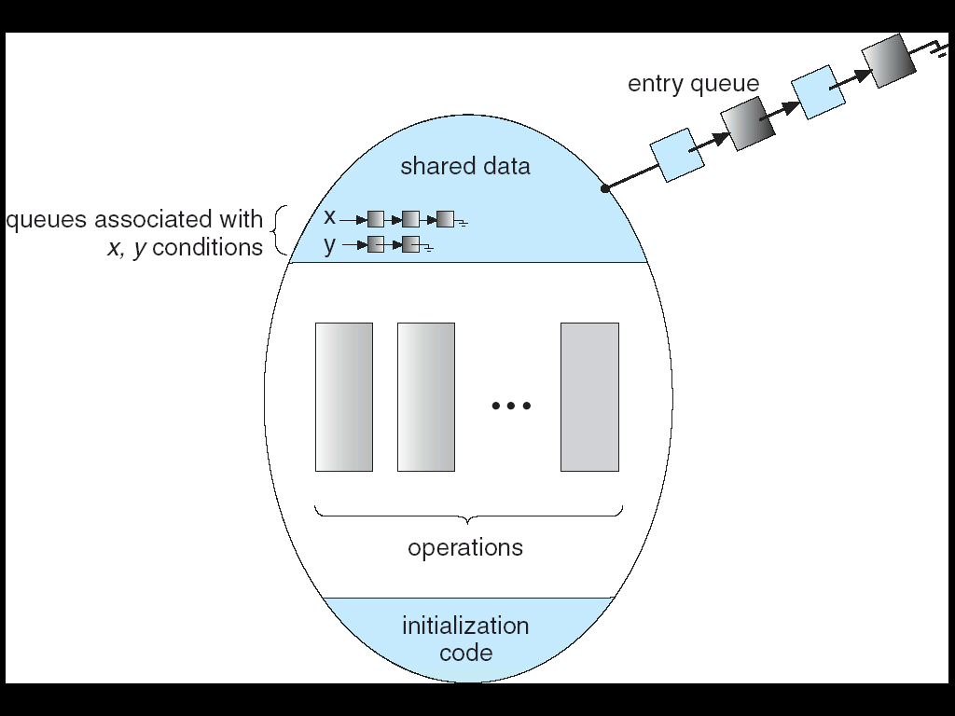
Monitor with Condition Variables
Lock: the lock provides mutual exclusion to shared data
Always acquire before accessing shared data structure
Always release after finishing with shared data
Lock initially free
Condition Variable: a queue of threads waiting for something inside a critical section
Key idea: make it possible to go to sleep inside critical section by atomically releasing lock at time we go to sleep
Contrast to semaphores: Can’t wait inside critical section

Slide 30
Simple Monitor Example (version 1)
Here is an (infinite) synchronized queue
Lock lock; Queue queue;
AddToQueue(item) { lock.Acquire(); // Lock shared data queue.enqueue(item); // Add item lock.Release(); // Release Lock }
RemoveFromQueue() { lock.Acquire(); // Lock shared data item = queue.dequeue();// Get next item or null lock.Release(); // Release Lock return(item); // Might return null }
Not very interesting use of “Monitor”
It only uses a lock with no condition variables
Cannot put consumer to sleep if no work!

Slide 31
Condition Variables
How do we change the RemoveFromQueue() routine to wait until something is on the queue?
Could do this by keeping a count of the number of things on the queue (with semaphores), but error prone
Condition Variable: a queue of threads waiting for something inside a critical section
Key idea: allow sleeping inside critical section by atomically releasing lock at time we go to sleep
Contrast to semaphores: Can’t wait inside critical section
Operations:
Wait(&lock): Atomically release lock and go to sleep. Re-acquire lock later, before returning.
Signal(): Wake up one waiter, if any
Broadcast(): Wake up all waiters
Rule: Must hold lock when doing condition variable ops!
In Birrell paper, he says can perform signal() outside of lock – IGNORE HIM (this is only an optimization)

Slide 32
Complete Monitor Example (with condition variable)
Here is an (infinite) synchronized queue
Lock lock; Condition dataready; Queue queue;
AddToQueue(item) { lock.Acquire(); // Get Lock queue.enqueue(item); // Add item dataready.signal(); // Signal any waiters lock.Release(); // Release Lock }
RemoveFromQueue() { lock.Acquire(); // Get Lock while (queue.isEmpty()) { dataready.wait(&lock); // If nothing, sleep } item = queue.dequeue(); // Get next item lock.Release(); // Release Lock return(item); }

Slide 33
Mesa vs. Hoare monitors
Need to be careful about precise definition of signal and wait. Consider a piece of our dequeue code:
while (queue.isEmpty()) { dataready.wait(&lock); // If nothing, sleep } item = queue.dequeue(); // Get next item
Why didn’t we do this?
if (queue.isEmpty()) { dataready.wait(&lock); // If nothing, sleep } item = queue.dequeue(); // Get next item
Answer: depends on the type of scheduling
Hoare-style (most textbooks):
Signaler gives lock, CPU to waiter; waiter runs immediately
Waiter gives up lock, processor back to signaler when it exits critical section or if it waits again
Mesa-style (most real operating systems):
Signaler keeps lock and processor
Waiter placed on ready queue with no special priority
Practically, need to check condition again after wait

Slide 34
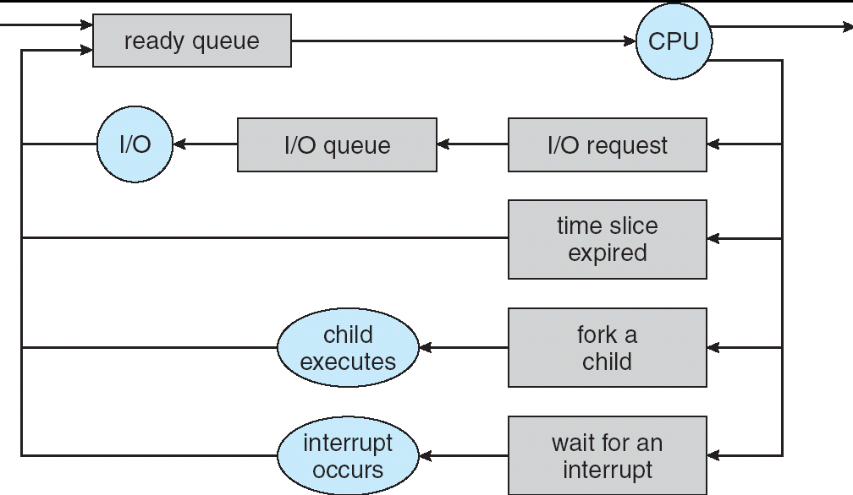
Recall: CPU Scheduling
Earlier, we talked about the life-cycle of a thread
Active threads work their way from Ready queue to Running to various waiting queues.
Question: How is the OS to decide which of several tasks to take off a queue?
Obvious queue to worry about is ready queue
Others can be scheduled as well, however
Scheduling: deciding which threads are given access to resources from moment to moment

Slide 35
Scheduling Assumptions
CPU scheduling big area of research in early 70’s
Many implicit assumptions for CPU scheduling:
One program per user
One thread per program
Programs are independent
Clearly, these are unrealistic but they simplify the problem so it can be solved
For instance: is “fair” about fairness among users or programs?
If I run one compilation job and you run five, you get five times as much CPU on many operating systems
The high-level goal: Dole out CPU time to optimize some desired parameters of system
USER1
USER2
USER3
USER1
USER2
Time

Slide 36
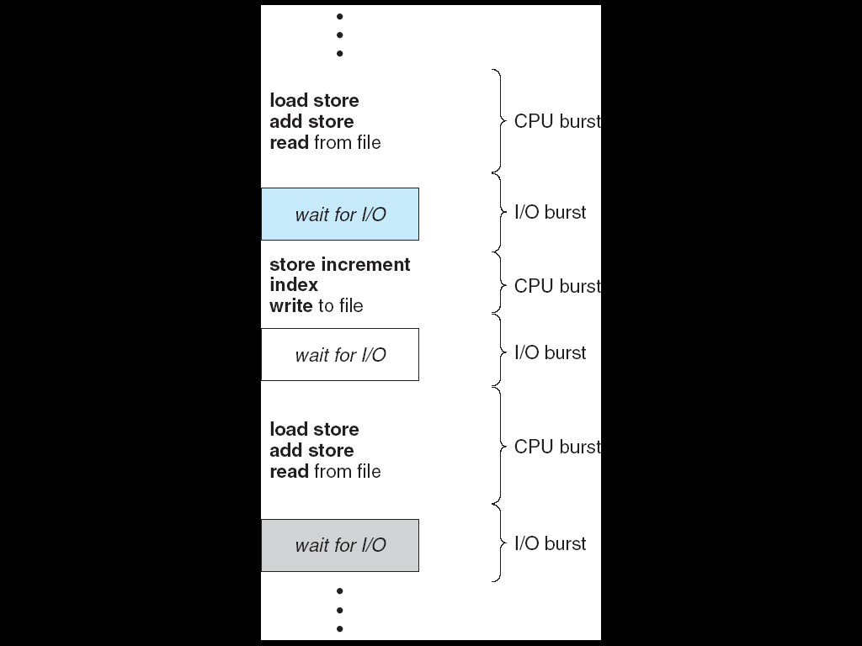
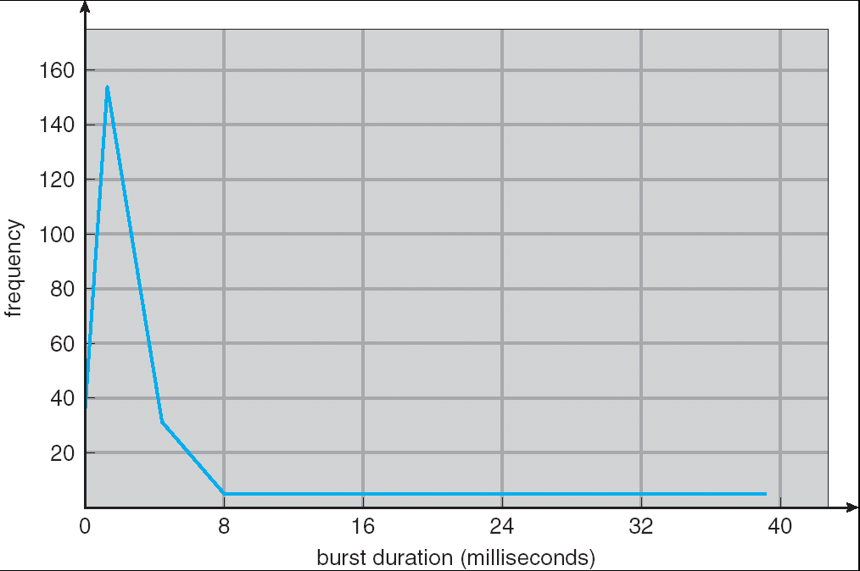
Assumption: CPU Bursts
Weighted toward small bursts
Execution model: programs alternate between bursts of CPU and I/O
Program typically uses the CPU for some period of time, then does I/O, then uses CPU again
Each scheduling decision is about which job to give to the CPU for use by its next CPU burst
With timeslicing, thread may be forced to give up CPU before finishing current CPU burst

Slide 37
Summary (1/2)
Important concept: Atomic Operations
An operation that runs to completion or not at all
These are the primitives on which to construct various synchronization primitives
Talked about hardware atomicity primitives:
Disabling of Interrupts, test&set, swap, compare&swap, load-linked/store conditional
Showed several constructions of Locks
Must be very careful not to waste/tie up machine resources
Shouldn’t disable interrupts for long
Shouldn’t spin wait for long
Key idea: Separate lock variable, use hardware mechanisms to protect modifications of that variable

Slide 38
Summary (2/2)
Semaphores: Like integers with restricted interface
Two operations:
P(): Wait if zero; decrement when becomes non-zero
V(): Increment and wake a sleeping task (if exists)
Can initialize value to any non-negative value
Use separate semaphore for each constraint
Monitors: A lock plus one or more condition variables
Always acquire lock before accessing shared data
Use condition variables to wait inside critical section
Three Operations: Wait(), Signal(), and Broadcast()
Scheduling: selecting a waiting process from the ready queue and allocating the CPU to it

